Slide 1


Welcome to Kindergarten 2024-2025

Slide 2
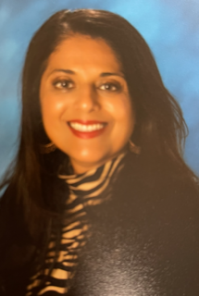

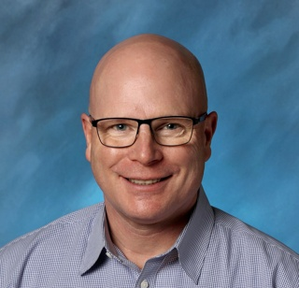
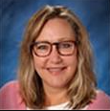
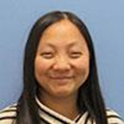
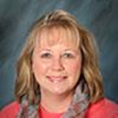

Welcome to Silver Firs Elementary
Thank you for coming!
Administration Team
Mrs. Aleta Smoot, Principal
Mr. Brent Radcliff, Asst. Principal
Mrs. Mary Fuda, Office Manager
Ms. Lizzy Sebring, Office Assistant
Mrs. Kim Nunnally-Hirata, School Counselor/Social Worker
Notes:
Hello and welcome to kindergarten orientation! We are excited to get to know you. On the screen, here is our school administration team that is here to support you as your child transitions to kindergarten.

Slide 3
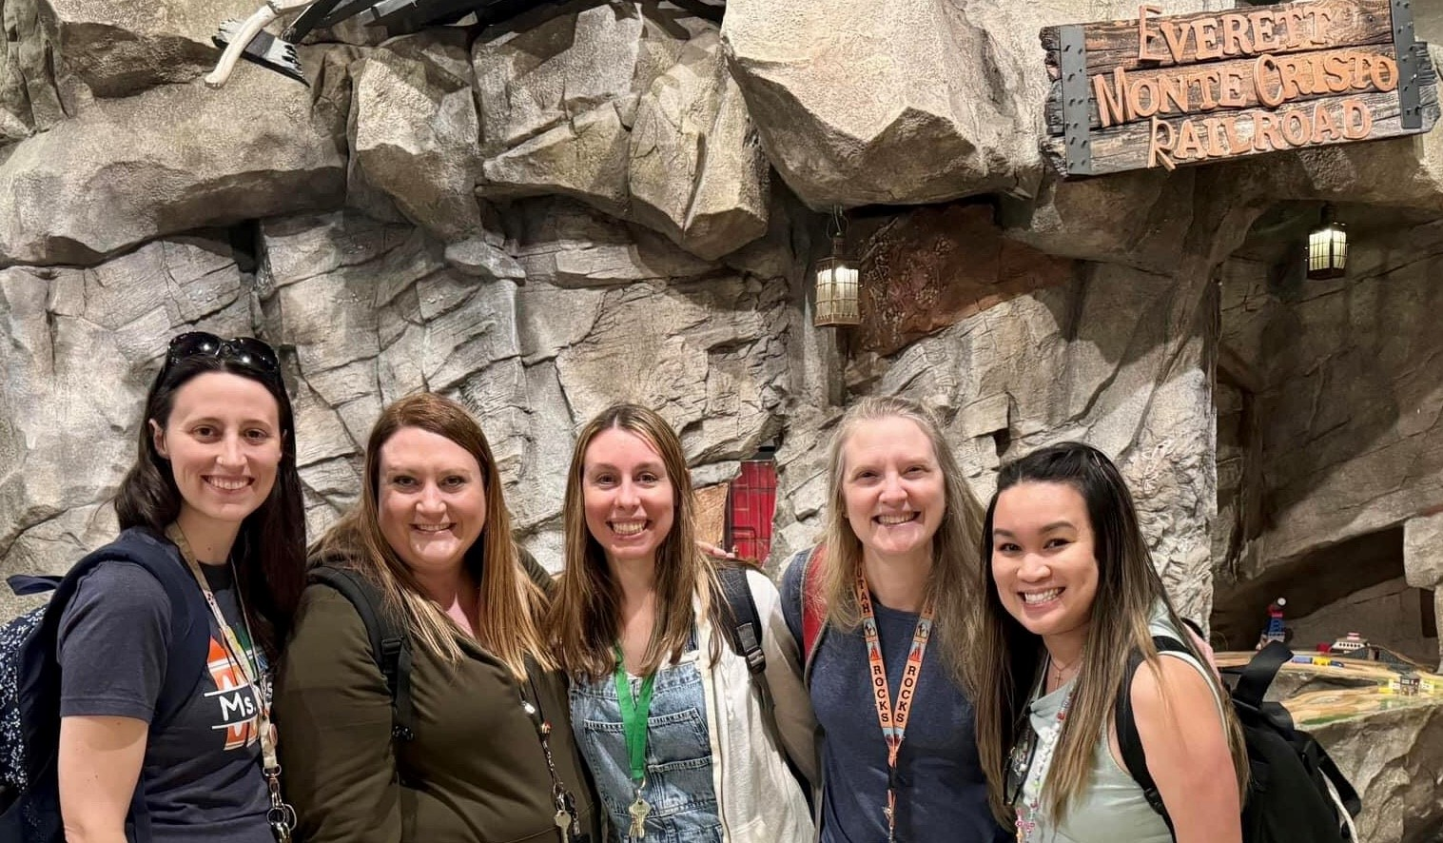
Presenting Our Teachers
Kindergarten Teachers
Ms. Whitney Massae
Mrs. Tarah Piukkula
Mrs. Cammy Cummins
Mrs. Marci Forsyth
Mrs. Jessica Lee
Notes:
Whitney We our so excited to be your Kindergarten team. From the left you can see Ms. Whitney Massae, Mrs. Tarah Piukkula, Mrs. Cammy Cummins, Mrs. Marci Forsyth, and Mrs. Jessica Lee

Slide 4
P.R.I.D.E. Expectations
Polite
Respectful
Independent manager
Doing our best
Everyone working cooperatively
Notes:
Our school-wide expectations anagram is P.R.I.D.E. P is for polite, R is for respectful, I is for Independent Manager, D is for doing our best, and E is for Everyone working cooperatively. We encourage our students to live these expectations each day in every area of the school where they have access. Teachers and staff give out P.R.I.D.E tickets to students who do an especially good job at following these expectations. Teachers collect them and once a month they pull names of students who earned the tickets. These students are then rewarded with an extra 10-minute P.R.I.D.E recess.

Slide 5

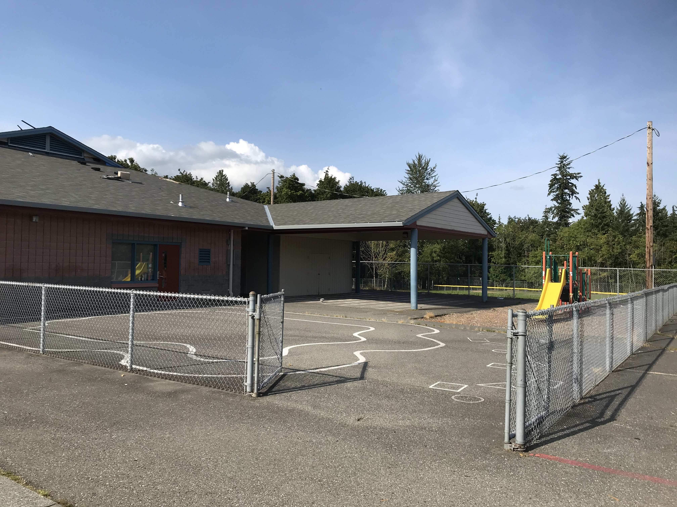
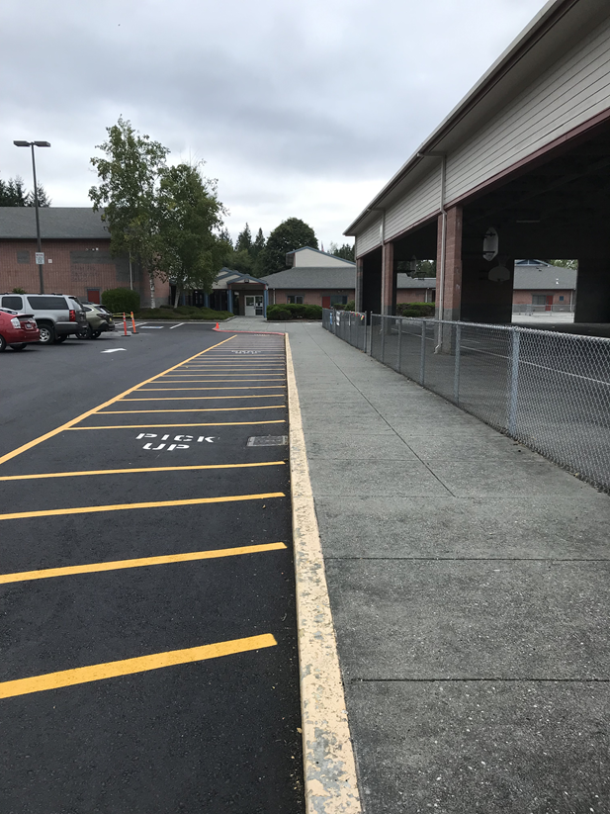
Kindergarten Corral and Kiss-and-Go Lane
Drop off and pick your students in the kindergarten corral.
X
Do not drop off or pick up kindergarten students in the kiss and go lane.
Kindergarten Corral
Kiss and Go Lane
Notes:
ALETA
The kindergarten corral is where you drop off and pick up students. Do not drop off or pick up kindergarten students in the kiss and go lane. We will show you where the kindergarten corral is located in our tour at the end of the presentation.
Even on the first day of school, please say your goodbyes at the Kindergarten Corral located in front of building A. Experience shows us, students transition much easier this way. Your child will take cues from you. Give a warm hug and a confident good-bye. We know how hard this can be, but the good news is IT WILL GET BETTER. We will provide a warm, caring environment for your child to help with the transition.

Slide 6


Everett Ready
Kindergarten begins with Everett Ready
Monday, August 19 – Thursday, August 22
At Silver Firs Elementary School
Half-day: 3 hours per day, 9:10 am – 12:10 pm Transportation provided for qualified students.
Build relationships with teachers and peers
Become familiar with the school campus
Learn school routines
Explore classroom materials
Feel safe and confident
Notes:
WHITNEY In Everett Public Schools, kindergarten begins with Everett Ready. Everett Ready is a week-long Kindergarten readiness program that takes place in August, and it gives our Kindergartners the opportunity to meet new friends, teachers, and staff, become familiar with the school campus, learn school routines, explore classroom materials, and feel safe and confident and ready for school. All enrolled Kindergarteners are automatically enrolled in Everett Ready. Students who participate in Everett Ready start school in September familiar with the environment, knowing some of their classmates, and ready to learn!

Slide 7

WaKIDS
Washington Kindergarten Inventory of Developing Skills
The Three Components
Family Connection Meeting – welcomes families into the Washington K-12 system as partners in their child’s education through a family conference with your child's teacher.
Whole-Child Assessment – helps kindergarten teachers learn about the skills and strengths of the children in their classrooms so they can meet the needs of each child.
Early Learning Collaboration – aligns practices of early learning professionals and kindergarten teachers to support smooth transitions for children.
Notes:
ALETA
While family connections is one of the important components of kindergarten, through WaKIDS there are two other components: Whole child assessment and collaboration between kindergarten and preschool teachers. WaKIDS ensures that children in Washington get a great start in kindergarten. All three components serve as a transition process that result in creating a pathway toward your child’s success in school.​
​

Slide 8

WaKIDS - Families First
Family Connection Meetings
Take place during the first 3 school days
Individual meeting with teacher, student, and family will be scheduled in August
Opportunities to:
  Get to know the teacher
  Share information about your child
  Ask questions
Notes:
​During the first three days of school for grades 1-12, kindergartners have family connection meetings with their child's teacher. These meetings are for the students, families, and teachers to get to know each other. You will get an email to sign up for your family connection meeting. All Kindergarteners will start school the following Monday.

Slide 9

WaKIDS
Notes:
ANCA This video if very helpful in further understanding WaKIDS. 4min Video: https://www.youtube.com/watch?v=zO7JAHpqLyU
​
​

Slide 10
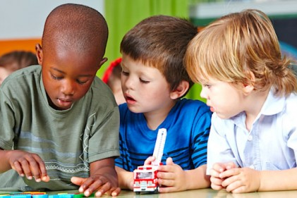
A Day in Kindergarten
Kindergarten Schedule
9:15 am to 3:30 pm
Specialists may include Physical Education, Library, Music, and STEM (Science, Technology, Engineering, Math)
Notes:
TARAH
Here is an example of what a typical day in kindergarten may look like.
The school bells rings at 9:10 for students to walk into school with their teacher. Class begins at 9:15.
We start the day with our morning routines of taking care of our backpacks, lunches and folders. Next up is morning circle which may include activities like songs, games and calendar time. This leads into our morning social emotional check in and social emotional learning lessons.
Our mornings are packed with fun literacy activities that cover phonics, reading and writing.
Students then have 20 minutes for lunch and a 20 minute recess.
Please dress your child appropriately for the weather.
After lunch we do math lessons and math centers.
Students will also attend a specialist class like PE, Library, Music or STEM.
In the afternoon students also have other activities like science, cross-curricular or extension activities, plan-do-reflect (which is our play based learning time) and 2nd 10 minute recess.
There is a balance of whole-group, small group and independent learning activities throughout the day. Sedentary components of the day are separated by the more active elements.
At the beginning of the year activities are shorter and then gradually increase as students build focus and stamina. Kindergarten transitions from looking more like preschool at the beginning of the year to looking more like first grade by the end of the school year.

Slide 11
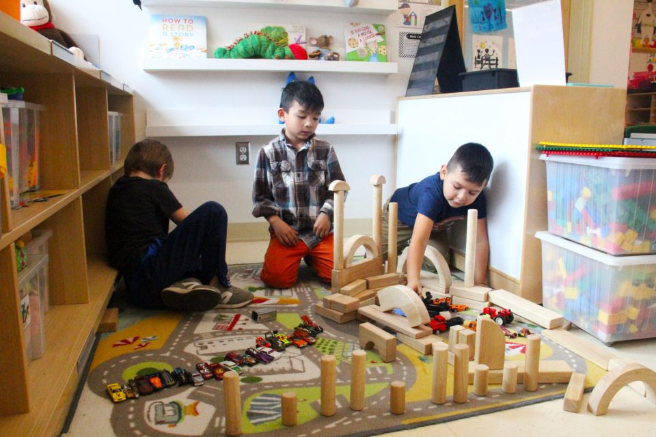
Plan – Do – Reflect (PDR)
A model of play-based learning
Plan – Choice with intention
Do – Develops competent thinkers, decision makers, and problem solvers
Reflect – Remembering & reflecting with analysis
Enhances creativity, critical thinking & problem-solving
Contributes to the development of self-regulation & social skills
Promotes physical well-being & coordination
Literacy-based materials encourage reading & writing
Enhances communication & collaboration
Develops character & citizenship
Notes:
TARAH The full day allows time for kindergarten children to learn through intentional choice, action and reflection. We call this part of the day Plan – Do – Reflect. This is a learning time that allows students the time to play with thought and intentionality.
They may choose from several different centers like dramatic play, writing, blocks, art, math, and much more! During this time students are working on many different skills like those you see listed here. Plan-do-reflect is one of their favorite parts of the school day!

Slide 12

Second Step – Social Emotional Learning
Second Step™ is our social emotion curriculum.
It teaches social skills and self-regulation skills like:
following routines, focusing attention, sharing, helping others, recognizing feelings, understanding emotions, calming yourself down, problem solving, interacting with children and adults, and how to have a growth mindset.
It’s a key to school readiness that supports children’s ability to be successful in both academic and social situations.
Notes:
TARAH
Kindergarten is more than just academics. It’s also about learning how to get along with others and how to manage oneself in a group setting. ​
Our second step curriculum helps teach students how to self-regulate and interact with others in various social situations. We focus on units that cover emotion management, empathy and kindness, problem solving and growth mindset

Slide 13
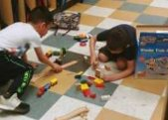
Illustrative Mathematics
The big ideas in kindergarten include; representing and comparing whole numbers, initially with sets of objects; understanding and applying addition and subtraction; and describing shapes and space. More time in kindergarten is devoted to numbers than to other topics.​
​
The mathematical work for kindergarten is partitioned into 8 units:​
Math in Our World​
Numbers 1–10​
Flat Shapes All Around Us​
Understanding Addition and Subtraction​
Composing and Decomposing Numbers to 10​
Numbers 0-20​
Solid Shapes All Around Us​
Putting It All Together​

Slide 14
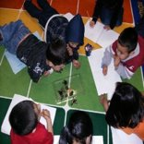
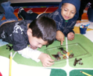
Science
Learn about​…
Life science​
Physical science​
Apply​…
Next Generation Science Standards practices and crosscutting concepts
Participate in STEM engineering challenges ​
Ask questions​
Observe​
Gather information​
Design​
Test ​
Compare possible solutions​
Notes:
CAMMY

Slide 15
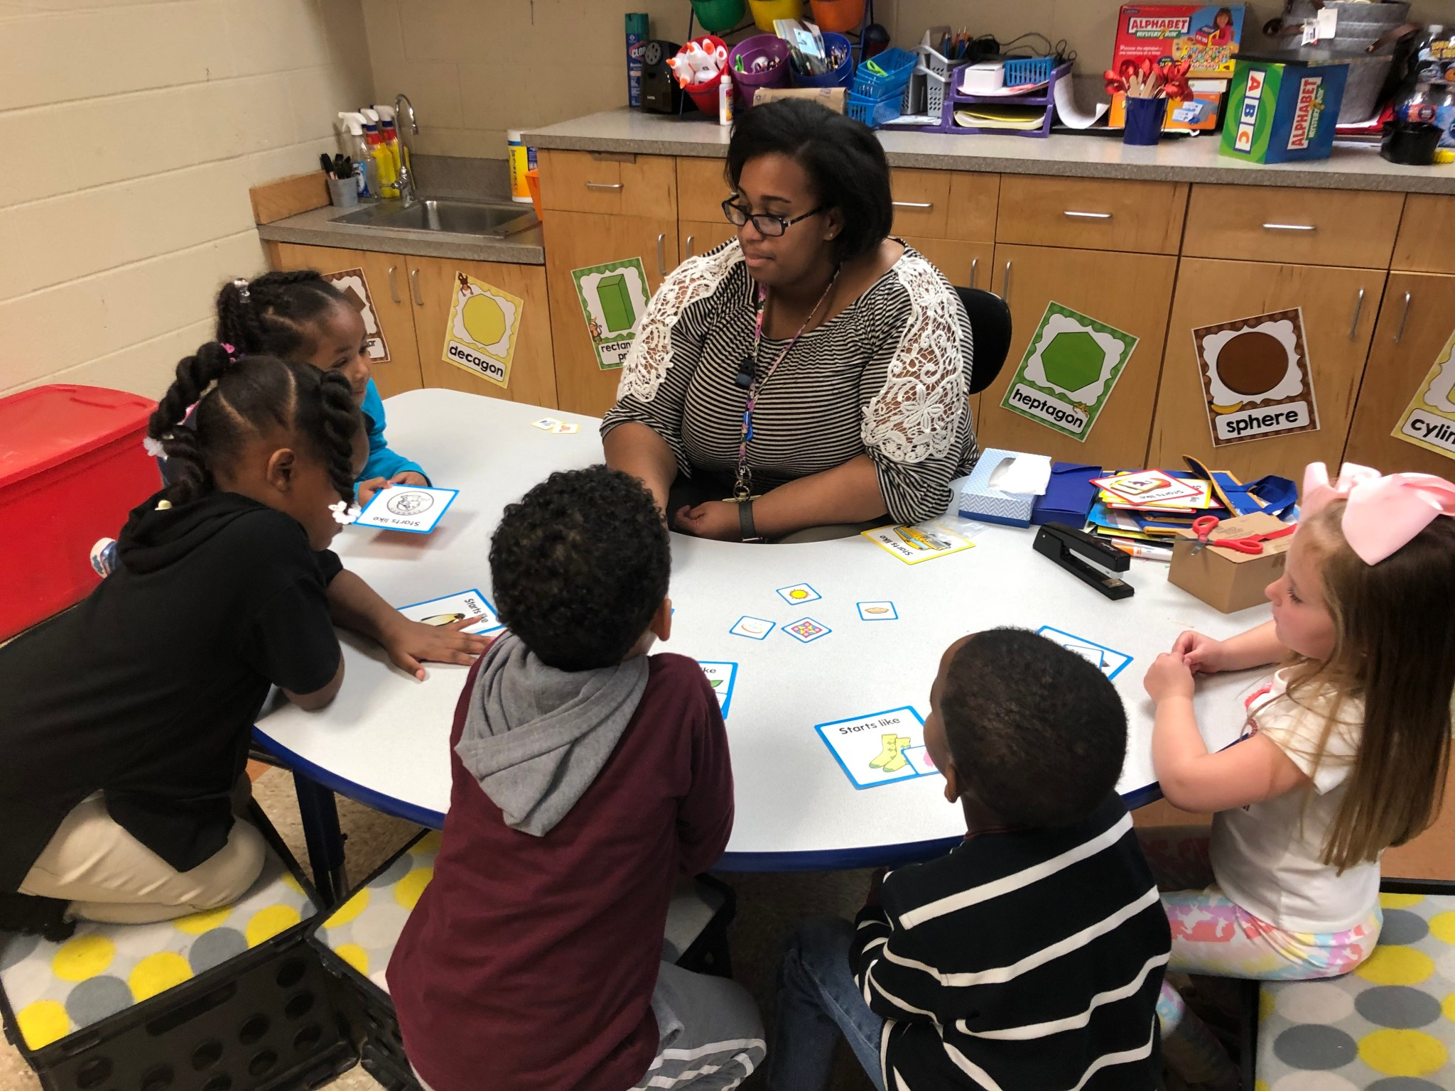
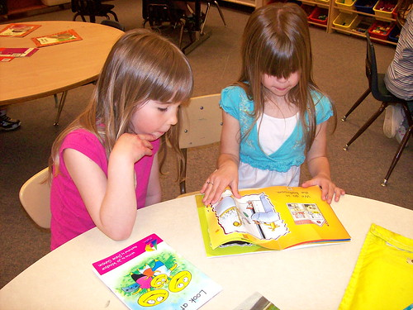
Reach for Reading
Reading Foundational Skills
Phonemic awareness​
Phonics​
Sight words​
Shared reading​
Small flexible groups​
Independent practice​
Notes:
CAMMY

Slide 16
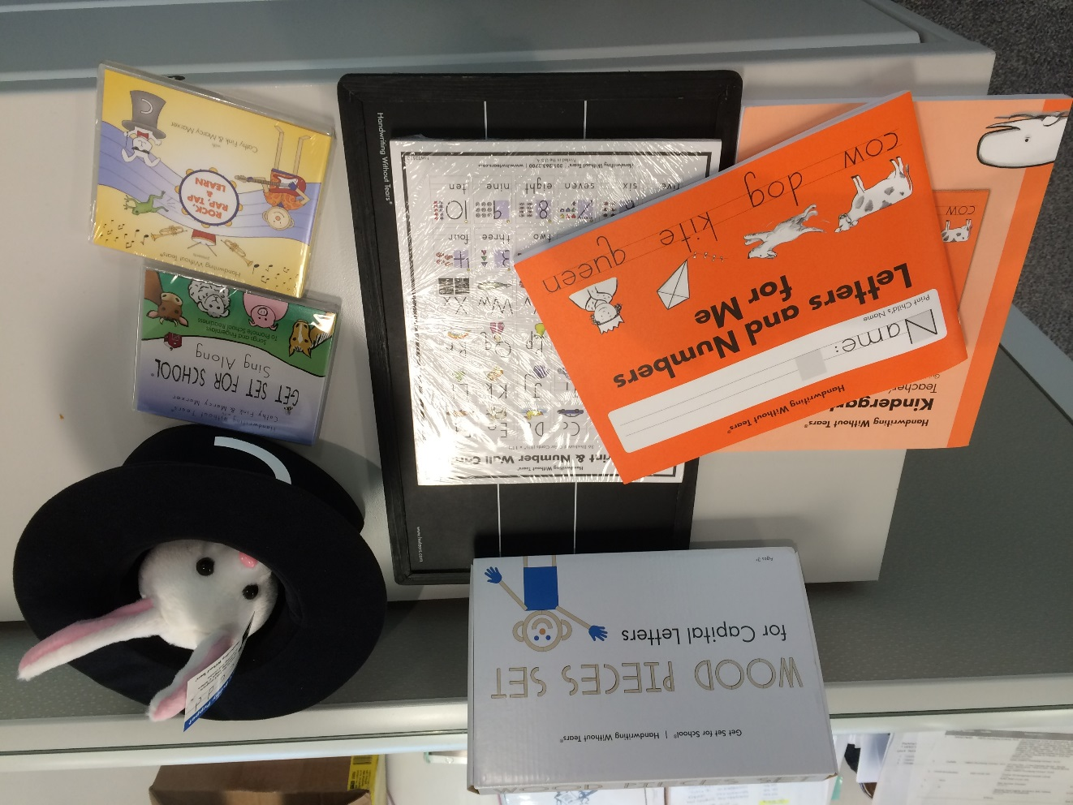


Writing Foundations and Handwriting Without Tears
Fine Motor Development
Pencil grip
Correct letter and number formation
Letter proportion and spacing
Building stamina for writing
Learning how stories work
Telling about a memory​
What happened?​
Who was there? ​
Where did it happen?​
How did you feel?​
What did you say?​
Notes:
CAMMY Everett Public Schools is using an aligned instructional writing strategy that develops student writing from PreK to 5th grade. ​
​
If your child has attended a ECEAP, Head Start or community preschool and childcare program that is a partner in this work, the materials and strategies will be familiar to them. The writing instruction focuses on the elements of a personal story and the child’s ability to communicate their stories through pictures and writing.​
​

Slide 17
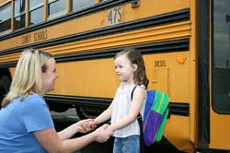
Transportation
Bus Transportation
Provided for students that reside outside a half-mile radius of the school
Designated bus stops located along routes in central locations
Routes are available on the district website prior to the start of school
Route information is communicated to families via automated phone call and email prior to start of school
All students have assigned seats with kindergartners in front of bus
Notes:
ALETA

Slide 18
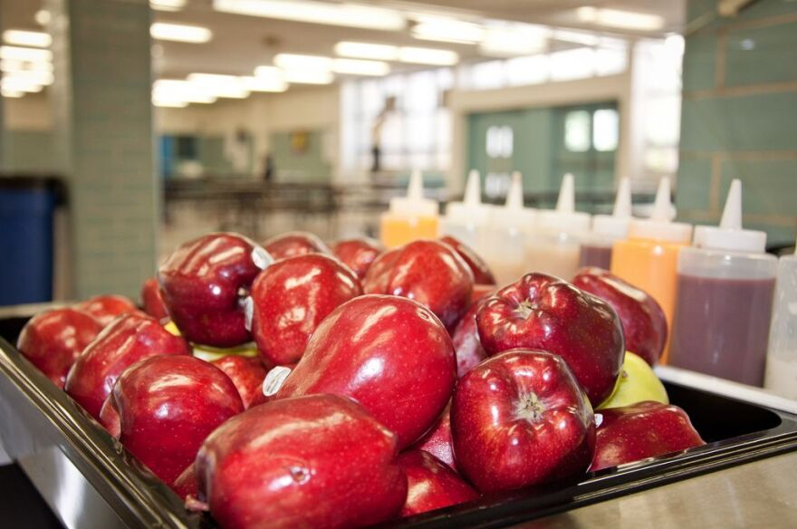
Food and Nutrition Services
Students can bring:
breakfast or purchase school breakfast
lunch or purchase school lunch
Families can set up an account for school breakfast/lunch.
School meals are prepared to be free of these allergens: tree nut, peanuts, pork and shellfish—if your student has other allergies, you can submit a Special Dietary Accommodation Request form.
Free and reduced meals are available.
To get more information or apply, visit our district website. Links to all forms may be found on our Food & Nutrition Website: www.everettsd.org/menus
Notes:
ALETA

Slide 19

Getting Ready for Kindergarten
Plan to attend Everett Ready
  Monday, August 19 to Thursday, August 22
  www.everettsd.org/everettready
Develop a home and bedtime routine​
Get supplies ready and labeled ​
Visit the school playground over the summer
Practice drop off and pick up routine
Help your child learn their personal information​ (first and last name)​
Help your child learn their student number
Notes:
WHITNEY
Before school begins in the fall, there are things you can do now to help your child prepare. Here are some tips that would help your child be ready for a full day of learning:
Plan to attend our Everett Ready program. This week-long program will help your child get familiar with our school and our kindergarten routines. We look forward to seeing you then!
Develop a home routine that helps your child be prepared to learn such as a regular bedtime and a consistent morning routine
Get supplies ready and labeled
Visit the school playground over the summer
Practice drop off and pick up routines
Help your child practice saying their first and last name, as well as parents first and last name, and parent phone number.
Help your child learn their student number: This is so important because it is how students will log into computers and get school lunch. If your child is getting lunch at school, knowing their student number will help ensure they have plenty of time to eat their lunch.

Slide 20

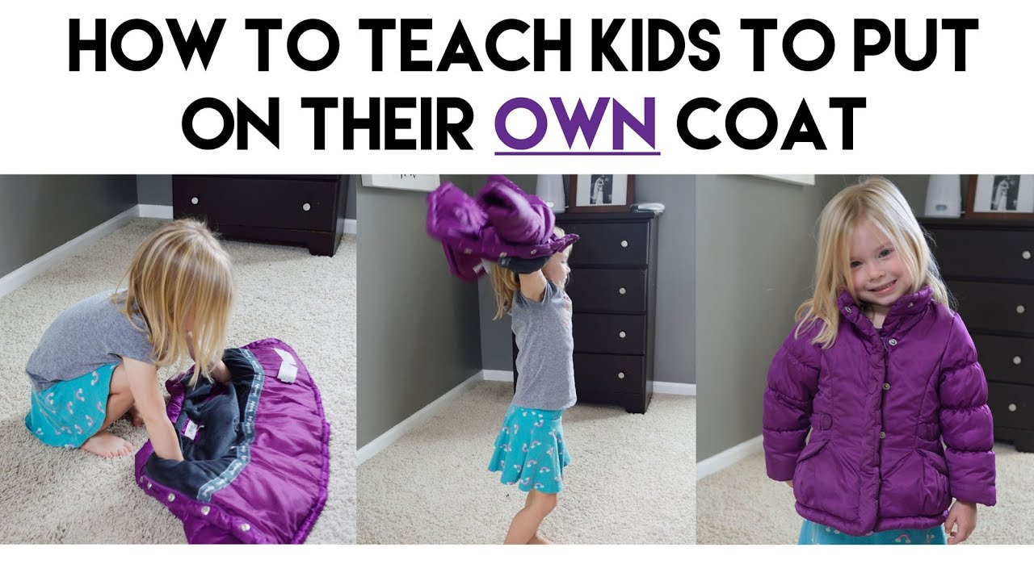
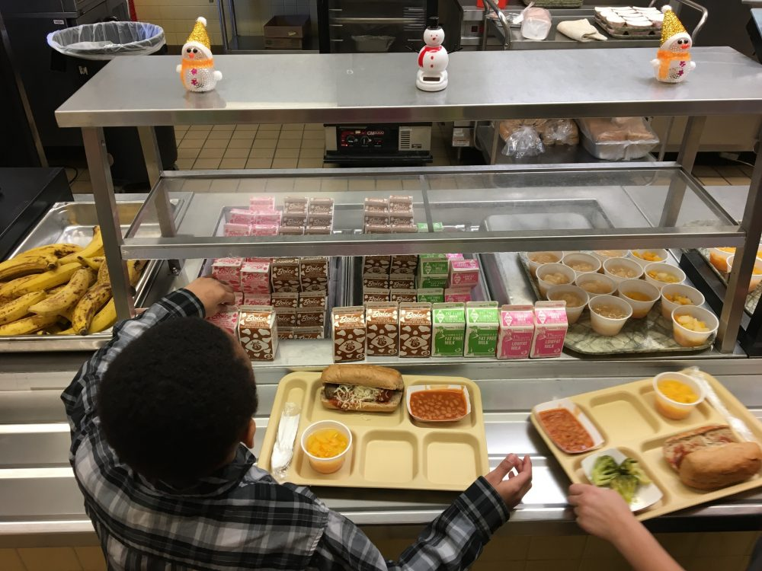
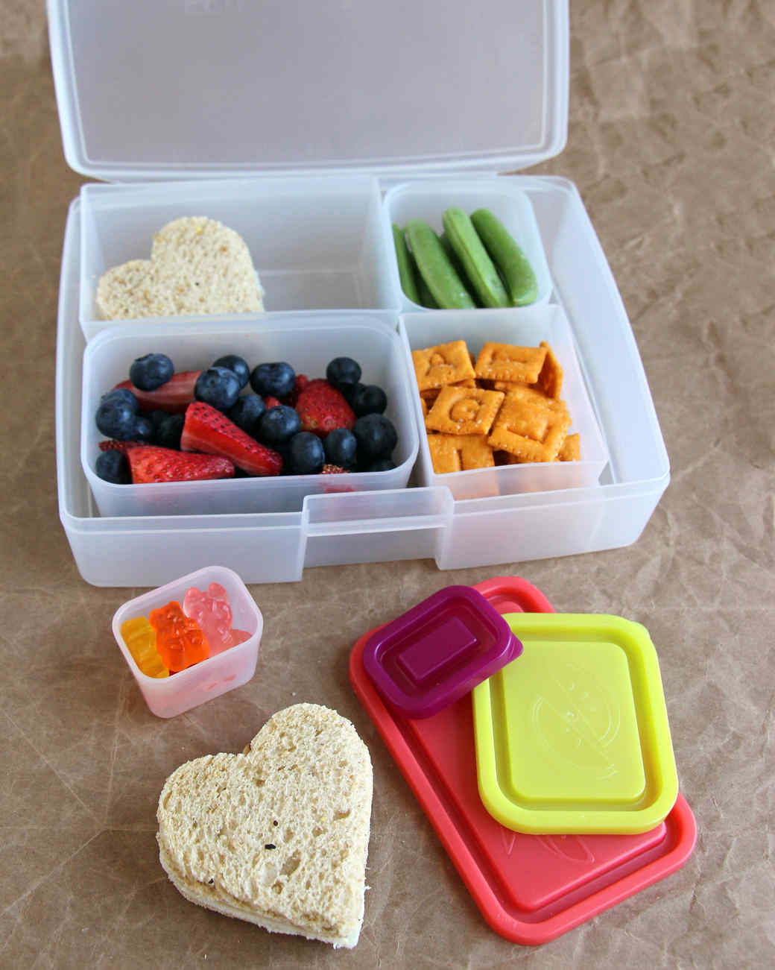
Creating Independence
Independently use the bathroom​
Put on, zip, and button coat​
Blow own nose​
Wash hands​
Open food & lunch containers​
Clean up small spills​
Put away materials​
Ask for help​
Notes:
Whitney
INDEPENDENT SKILLS are important for success in school. Each student will enter kindergarten with a different set of skills. Students will increase their level of independence throughout the school year. The following skills will be helpful for the beginning of the school year:
* zip and button coat
* put on backpack
* tie shoes
* blow nose
* use the bathroom
* wash hands
* turn taking
* waiting patiently
* asking for help
* cleaning up a work/play area
* listening to others and contributing to a conversation
* work independently for up to 20 minutes

Slide 21

Family Involvement
Ways to support your child’s learning
​
Make attendance a priority​
Come to school and family events​
Participate in WaKIDS family meeting and parent teacher conferences ​
Help with class projects/work​
Volunteer​
Join PTA or Natural Leaders​
Notes:
ANCA Families are children’s first teachers. As children start school you, the parents and guardians, continue to have the most important role. Schools and parents are partners in supporting children’s learning and growth. We invite you to work with us as a team for your child’s success.​
​
Here are some opportunities to get involved.
Coming to Parent-Teacher Conference​, Curriculum Night, Math and Reading Nights, and so on.
Opportunity to let the teacher know more about your child; after all you know your child best​
Learn about what children do in classroom and how your child is progressing ​
Ask questions​
Volunteering – in the classroom, at home (cut out materials), or for events at school​
PTA – Book fair, Carnival, Grounds Clean-Up​
​

Slide 22

Before and After School Program
YMCA
6:00 am – 9:10 am
3:30 pm – 6:00 pm
In the school cafeteria
Notes:
ANCA At Silver Firs we partner with YMCA to offer before and after school care to our students in the school cafeteria. The YMCA is open from 6 am until 9:10 am, when school starts, and from 3:30 pm (dismissal time) until 6:00 pm. Please contact our school office to learn how to enroll.

Slide 23

Attendance
Consistent attendance is important for your child’s development
Please schedule vacations when school is not in session (during summer, winter, or spring breaks)
Report your child’s absence by emailing SFEAttendance@everettsd.org
You know your child best. If they are too sick to attend school, please keep them home. Standard guidelines for keeping ill children at home:
          Fever of 100 degrees or more
          Vomiting within last 24 hours
          Diarrhea within last 24 hours
Notes:
ANCA Attendance Letters FYI; keep your child home when sick, regardless of COVID; report absences to the attendance line. We highly encourage parents to take trips when school is not in session, such as during summer, winter or spring breaks. Missing more than a few days of school can significantly impact your student’s learning.

Slide 24

Questions?
If you have questions about your child’s development or readiness for kindergarten, please contact:​
Mrs. Aleta Smoot – School Principal
asmoot@everettsd.org
Mr. Brent Radcliff– Assistant Principal
bradcliff@everettsd.org
SFE Phone 425-385-6500
Special Services 425-385-5250
Notes:
ALETA

Slide 25
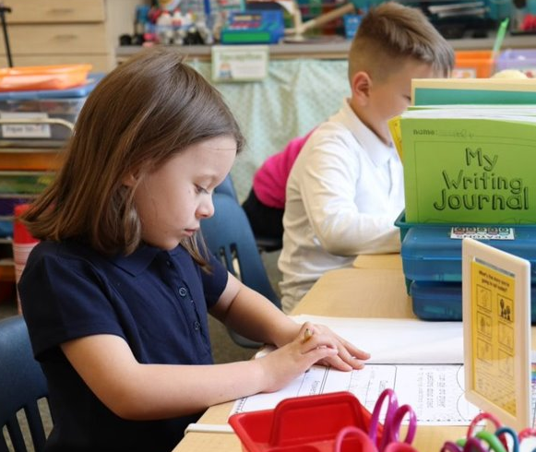

THANK
YOU!
.

